Slide 1
TRENDING VIDEOS ON YOUTUBE IN DIFFERENT COUNTRIES
GROUP NAME: THE AGGREGATORS

Slide 2
DATASET
Data set is a record of the top trending YouTube videos in different countries.
Data includes the video title, channel title, publish time, tags, views, likes and dislikes, description, and comment count, etc.
The shape of the dataset is 16580 rows * 16 columns
Time frame 2008-2018

Slide 3
Exploratory Data Analysis
Ratio of likes-dislike of all categories
Top 5 trending video category in each country
Users like videos from which category the most
Most liked video is not the most trending video
Days for trending status
Most used words in Tags and Descriptions

Slide 4
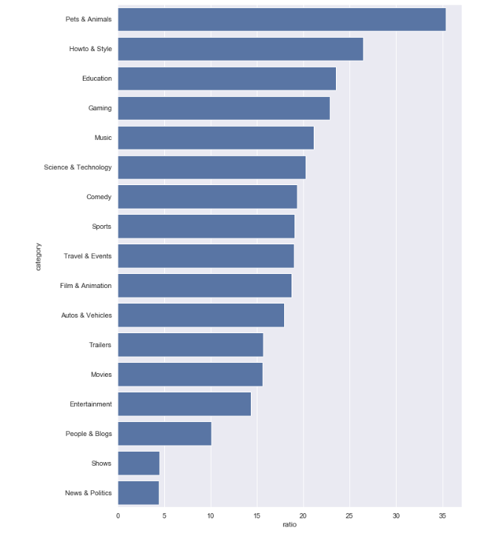
Ratio of likes-dislike of all categories
Pets and animals videos are the most liked ones
News and politics videos are the most disliked ones

Slide 5
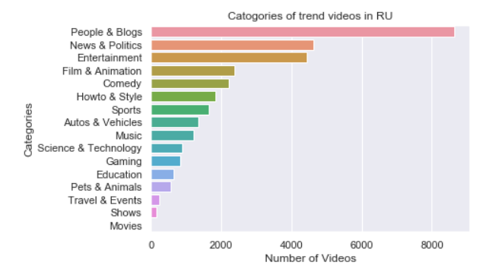
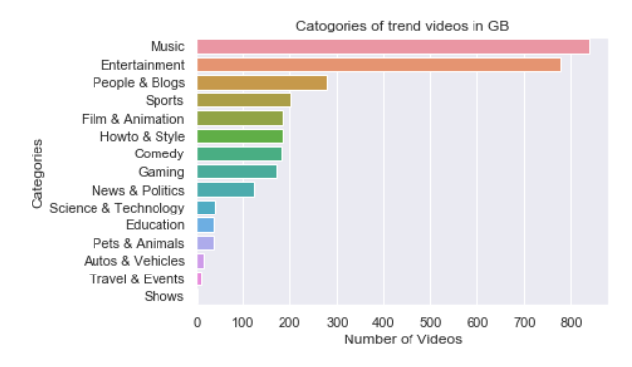
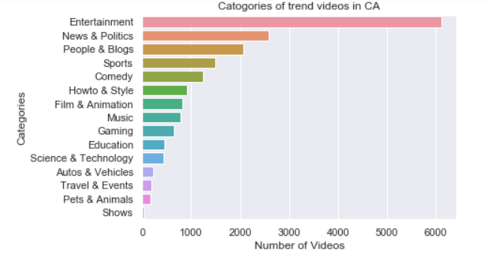
Users like videos from which category the most

Slide 6
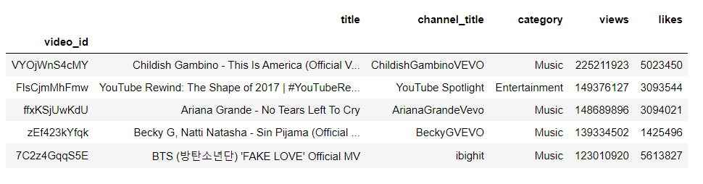
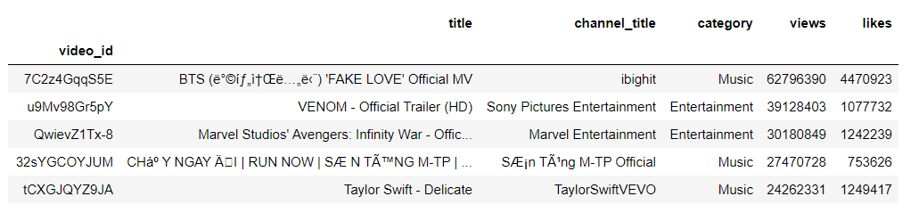
Top 5 trending videos in each country

Slide 7
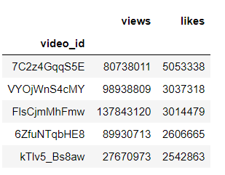
Most liked video is not the most trending video

Slide 8
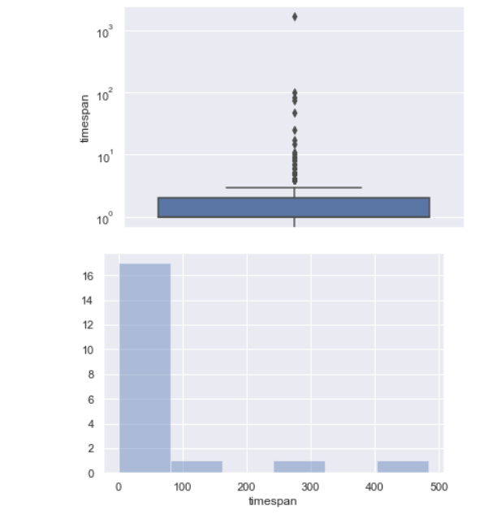
Days for trending status

Slide 9
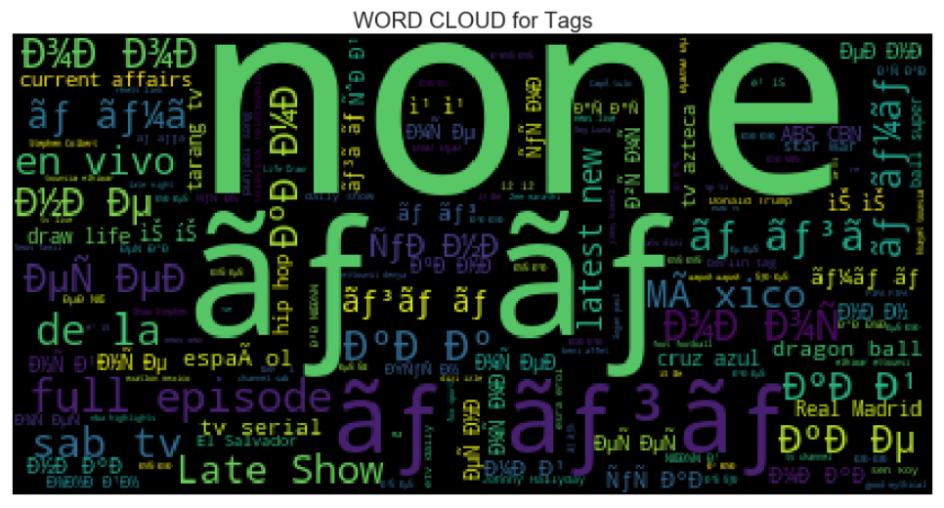
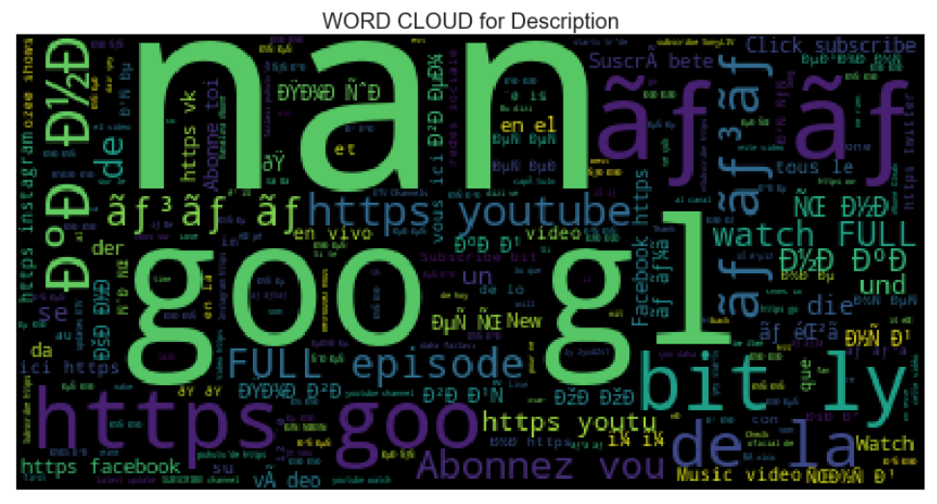
Most used words in Tags and Descriptions

Slide 10
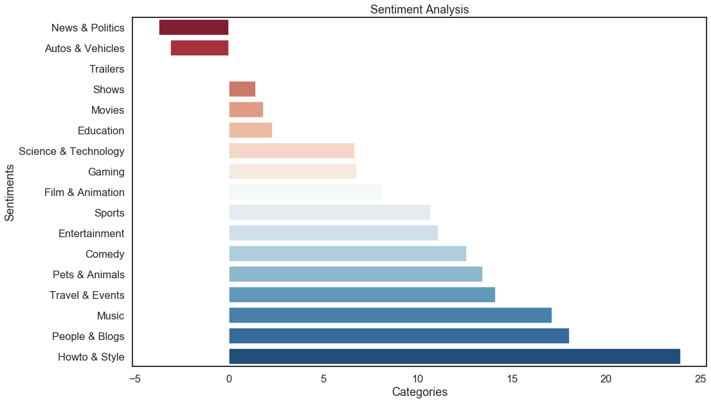
Machine Learning Algorithm
Sentiment Analysis
Most positive sentiments = ‘HowTo & Style’
Most negative sentiments = ‘News and Politics’
Used function = SentimentIntensityAnalyzer()

Slide 11
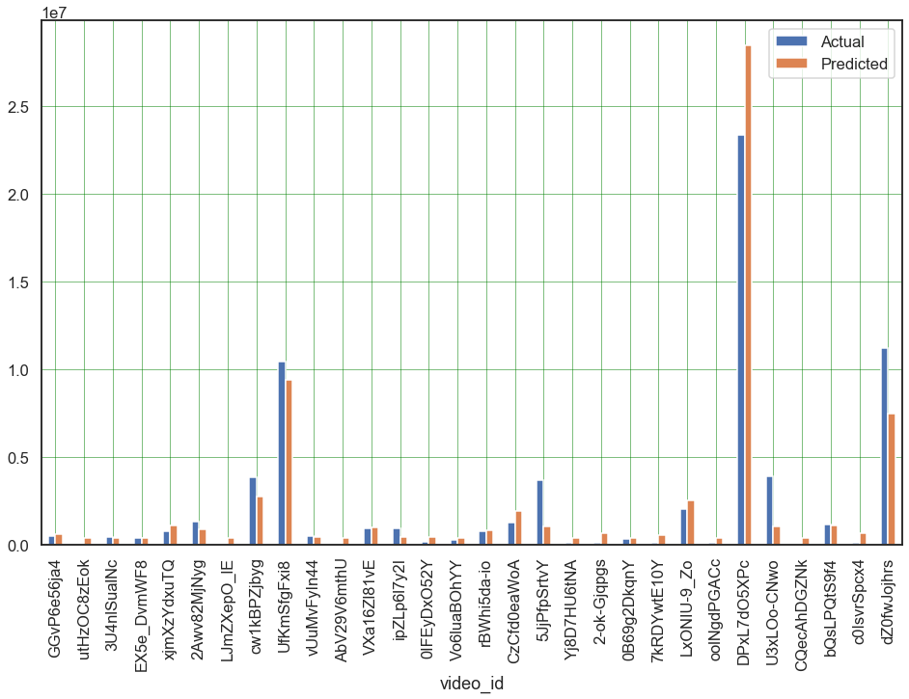
Machine Learning Algorithm
Linear Regression
Model score = 0.734751
Difference between Predicted Values and Actual Values

Slide 12
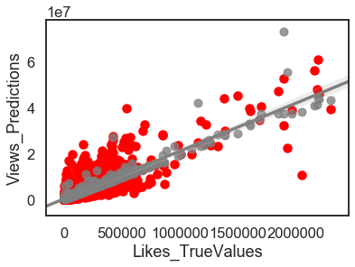
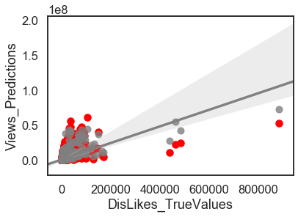
Machine Learning Algorithm
Scatter Plots

Slide 13
Interested Findings
An interesting Find we came upon was that for every 21 views there was 1 like on the video. Similarly, for every 43 views there was 1 dislike on the video. This shows that not only likes but dislikes are Also dependent on the number of views on the video as well.
To check if this was a meaningful find we decided to research how youtube’s trending algorithm works, and we found out that our find is supported by the working of youtube’s Auto balancing feature.
One other fascinating find was that the Most viewed videos are not the Most liked videos.

